Slide 1
Covert Channel Research
Jonathan, Salaj and Arif
Camaleonte
4th, August 2025

Slide 2


Agenda
Introduction
Design Philosophy
Mediums
Protocol
Multiple Clients
Metasploit Integration
Demonstration
Conclusions

Slide 3
Introduction

Slide 4


Customer Specifications
Purpose:
Train Swiss Cyber Operators
[1]

Slide 5
Customer Specifications
Purpose:
Train Swiss Cyber Operators
Requirements:
Works on Linux
Communicates through shared drives
Filesystem-agnostic
Sufficient bitrate
[1]

Slide 6
Customer Specifications
Purpose:
Train Swiss Cyber Operators
Requirements:
Works on Linux
Communicates through shared drives
Filesystem-agnostic
Sufficient bitrate
Capabilities:
Arbitrary command execution
Data exfiltration
Handles multiple connections
[1]

Slide 7
Customer Specifications
Purpose:
Train Swiss Cyber Operators
Requirements:
Works on Linux
Communicates through shared drives
Filesystem-agnostic
Sufficient bitrate
Capabilities:
Arbitrary command execution
Data exfiltration
Handles multiple connections
Stretch Goals:
Integrate with Metasploit
Cross-platform compatibility
[1]

Slide 8

Customer Specifications
Purpose:
Train Swiss Cyber Operators
Requirements:
Works on Linux
Communicates through shared drives
Filesystem-agnostic
Sufficient bitrate
Capabilities:
Arbitrary command execution
Data exfiltration
Handles multiple connections
Stretch Goals:
Integrate with Metasploit
Cross-platform compatibility
[1]

Slide 9
What is a Covert Channel?
MITRE Definition: A way to transfer data that was not intended by the system’s designer [2].
Covert channels “hide in plain sight”
Often rely on unconventional methods
Challenge of balancing stealth and data throughput
Design choices of medium and protocol

Slide 10
Design Philosophy

Slide 11
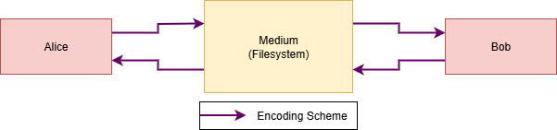
Mediums
All filesystems in a covert channel must…
List files
Read files
Write files

Slide 12
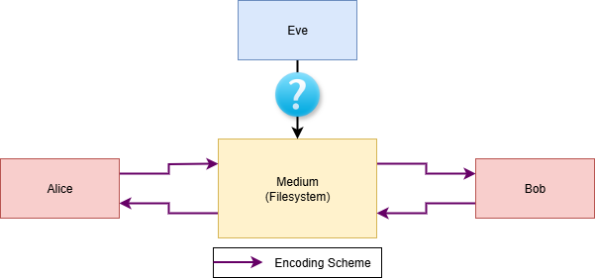
Mediums

Slide 13



Mediums
Filesystem
Linux
Cloud
[3]
[4]
[5]

Slide 14
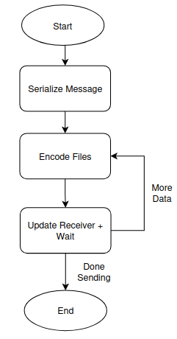
Protocol: Overview
Abstract transmission protocol that supports multiple encoding schemes based on user needs
Hash Based Encoding:
Low data throughput
Obscure method
Metadata Based Encoding:
Higher data throughput
Prevalent covert channel medium
Notes:
OLD Content
Strengths:
Constant file size
“Lightweight” operation
File type-agnostic
Weaknesses:
Medium-dependent
Behavioral Signature

Slide 15
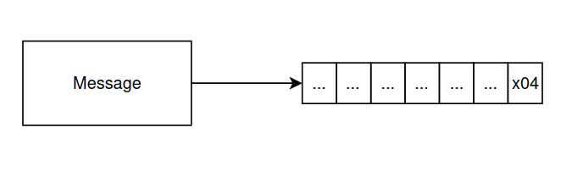
Protocol: Serialization
Break data up into file sized chunks
Hash can encode 1 byte per file
Metadata chunk size depends on medium
Append a terminator at the end of the message
Lets receiver know when to stop reading
Notes:
Chunks are different sizes based on the encoding used
Hash: 1 byte
Metadata: depends on filesystem
Drive: ~2kb
Linux:

Slide 16
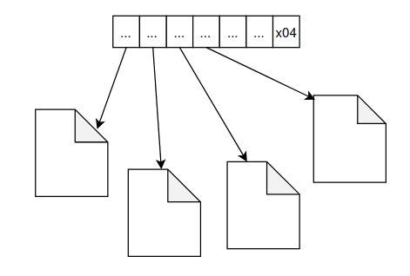
Protocol: Transmission
Sender encodes all available files in mediums
Files are written to in alphabetical order
4 bytes are reserved for checksum hash
Hash based encoding
Modify file content until desired hash outputted
Metadata based encoding
Encode data into file hidden metadata properties
Notes:
OLD Content
Strengths:
Constant file size
“Lightweight” operation
File type-agnostic
Weaknesses:
Medium-dependent
Behavioral Signature

Slide 17
Protocol: Signaling
The sender and receiver exchange signals to indicate the next state
Signals used for error correction, synchronization, and operation acknowledgement
CLEAR | Sent to indicate an idle state
DONE | Sent by sender when done writing current batch
ACK | Sent by receiver when latest batch received and verified successfully
NACK | Sent by receiver when latest batch received but verification failed
Notes:
OLD Content
Strengths:
Constant file size
“Lightweight” operation
File type-agnostic
Weaknesses:
Medium-dependent
Behavioral Signature

Slide 18
Additional Features

Slide 19
Multiple Clients
Reallocate shared files depending on the number of clients
This effectively creates a “virtual file system”
S
S
S
Client
New Client!
Client
New Client!
Client
S
Client
S
S
Client
Client
S
X

Slide 20

Metasploit
Currently Implemented:
Custom Metasploit file system listener
Includes all covert channel functionality
Session creation
Basic C2 capabilities (upload, download, execute, etc.)
Backgrounding + clean exits
Still Needs:
Heartbeat for timeouts and disconnects
Persistent listener
[6]

Slide 21
Demo

Slide 22
Conclusions

Slide 23
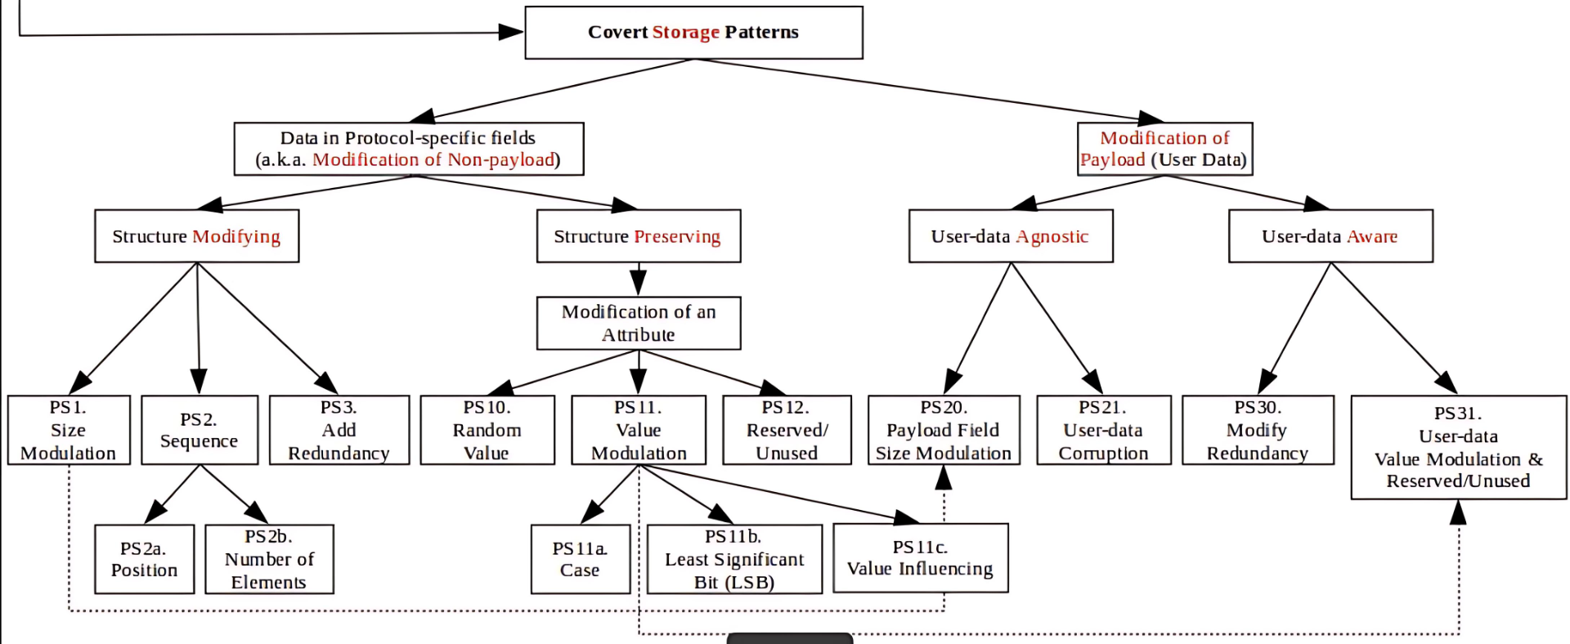
Taxonomy
[7]
Hash
Metadata

Slide 24
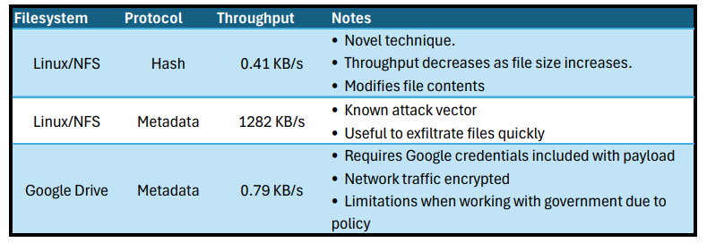
Summary

Slide 25
Future Work
Covert Channel:
Provide advanced options to the user
Sync file poll rate
Jitter rate
Improve hash protocol encoding
Test in live environments to assess covertness
Restore files to original state after message transmission
C2 Capabilities:
Pivoting
Msfvenom payload generation
Persistent server listener

Slide 26
Questions?

Slide 27
References:
https://cyesec.com/blog/red-team-vs-blue-team-cybersecurity-they-can-help-your-business
https://cwe.mitre.org/data/definitions/514.html
https://en.wikipedia.org/wiki/Tux_%28mascot%29
https://www.flaticon.com/free-icon/nfs_9748993
https://www.vecteezy.com/png/12871368-google-drive-icon-google-product-illustration
https://www.linkedin.com/products/isoc24-b-v--metasploit-rapid7/
https://patterns.omi.uni-ulm.de/NIHPattern/

Slide 28
Appendix

Slide 29
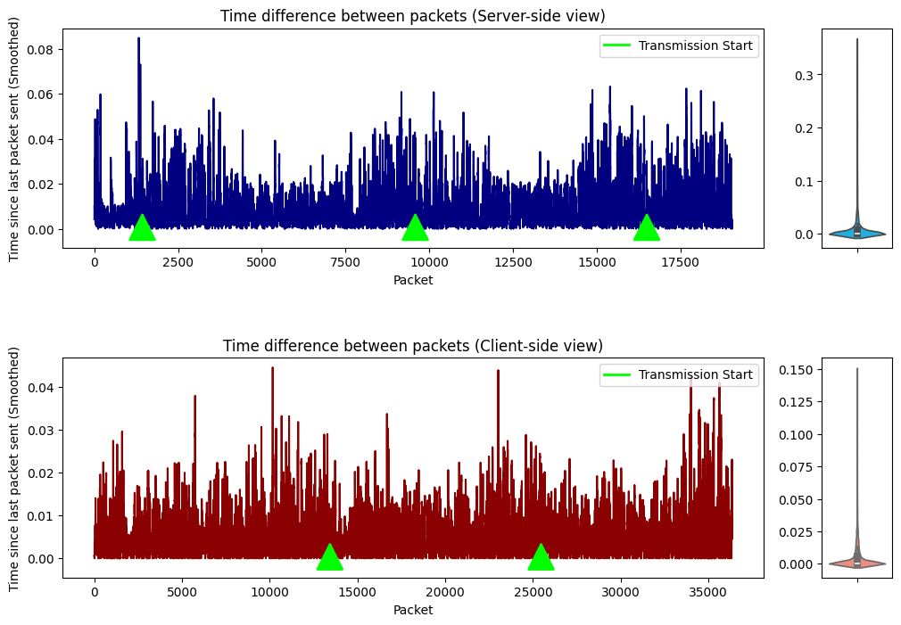
Appendix A: Network Analysis
When sending packets, there is an increase in traffic frequency which is reproducible
Notes:
To add to this slide, the IDS systems we were wanting to test didn’t really have file monitoring capabilities. I used auditd to generate.

Slide 30
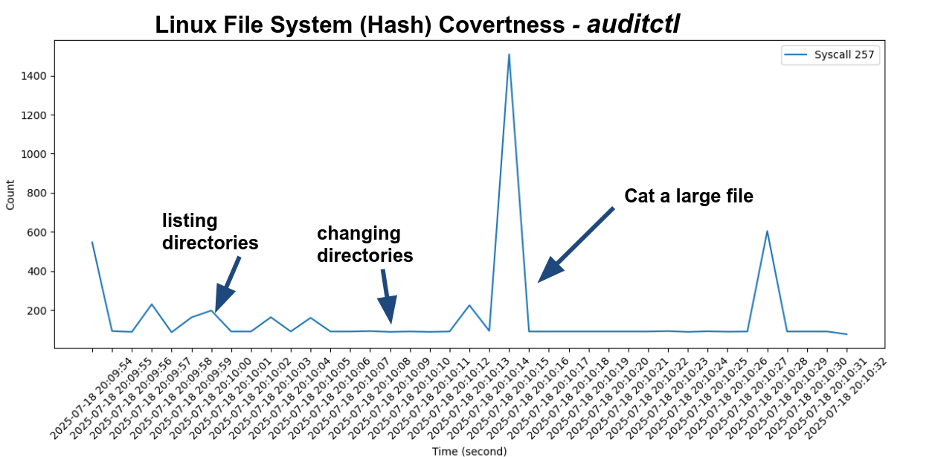
Appendix B: Filesystem Analysis
Notes:
SYScall 257 is an opening of a file or creation of new files. This is the fileshare directory itself being monitored over the point of the communication process on linux systems. We can observe an increased spike in SYSCALL 257s. The communication begins at this process and continues until we observe another spike. Actions themselves have
auditctl was used to create this plot.

Slide 31
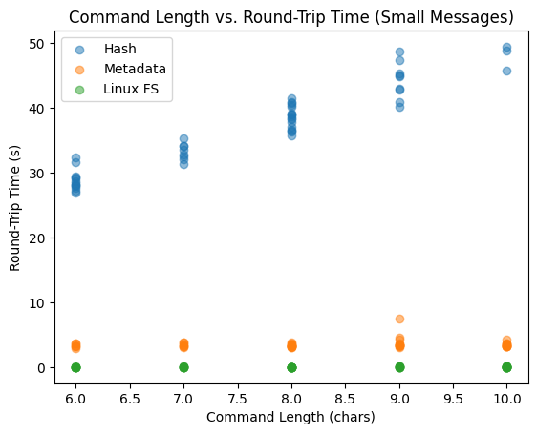
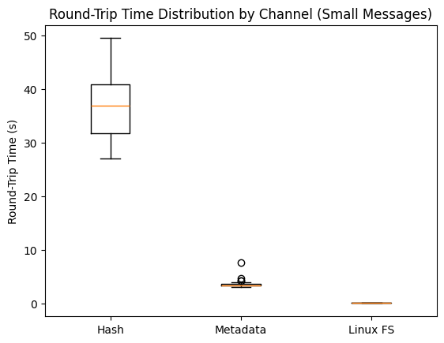
Appendix C: Transmission Speed
Note: This data is based on week 4 implementation.
Notes:
Explain how the increased variation in the google hash transfer is understandable due to the different hashes being produced and the stochastic nature of writing those to the file.

Slide 32
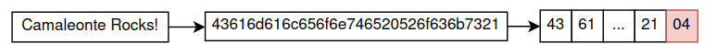
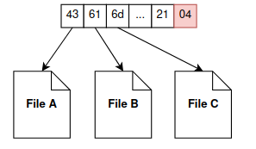
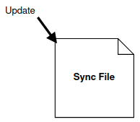
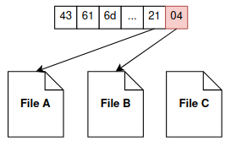
Appendix D: Protocol Steps
Sending:
Choose a sync file
Append terminator to message and split into chunks
Encode chunks into as many files as you can
If more chunks to write
Send signal to receiver and wait for response
Back to step 2
Receiving:
Choose sync file
Wait for signal to start reading
Decode chunks from all files
If terminator not decoded:
Back to step 2
Hash Based Example

Slide 33
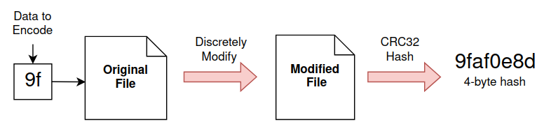
Appendix E: Hash Based Encoding
Retrieve current file data
Hash using crc32 algorithm
If first byte doesn't match the data to encode
Add a space to file data
Go back to step 2
Overwrite file data with

Slide 34
Appendix F: Hash Based Analysis
Assumptions:
Defender will not closely monitor filesystem
Pre Existing UTF-8 encoded files
No other users actively writing to files
Risk Assessment:
Susceptible to system noise
Cannot be mitigated
Requires files to be present
Can make our own files
Will compromise integrity of transferred data
Add integrity checks to messages (checksums)
✅Pros:
Uncommon technique
Blends in with existing files
Location of data doesn’t need to be sent
❌Cons:
Low data throughput
Slower for larger file sizes
Speed depends on how many files exist on system

Slide 35
Appendix G: Metadata Analysis
Assumptions:
Necessary permissions
Evades IDS Detection
Apps or programs do not write to same files
Risk Assessment:
Susceptible to system noise
Error correction and file mappings
IDS Detection
Limit throughput or hide traffic with specific mediums
✅Pros:
High data throughput
Minimal resource signature
Capacity to exfiltrate files
Does not depend on file type
❌Cons:
Transmitted in plaintext
IDS actively monitors metadata
Implementation changes based on platofrm

Slide 36
🇨🇭🤫📁

